Slide 1
CS 4974 Independent Study
9/15/22 meeting
Student: Bug Lee

Slide 2
Last time, we discussed…
Regular expression and State Machine in Lexer
Recursive descent parsing
However, for assembler, instruction lookup table was used instead of recursion
Starting Code Generation

Slide 3
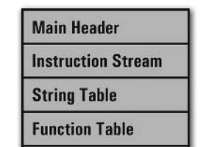
Week 3
compiler
assembler
script.source
script.assembly
script.executable
Virtual Machine
CPU

Slide 4
Code Generation

Slide 5
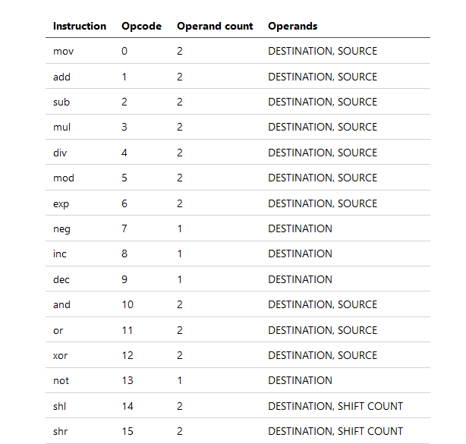

Slide 6
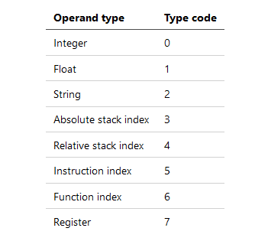

Slide 7
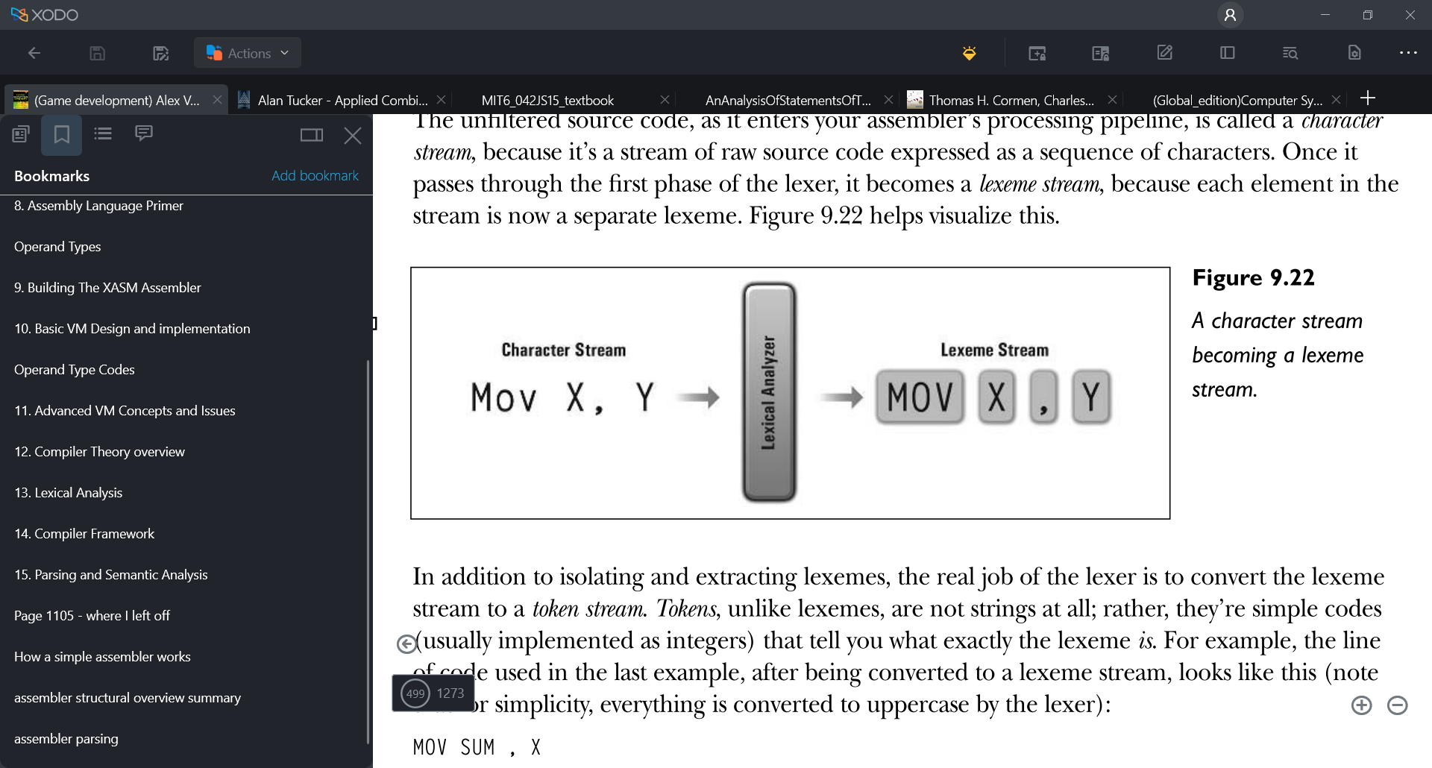
Parse Instruction
26 | 1 | 0 | 42 | 0
push
42
Parser
Opcode
Op count
Op type
Op value
Offset
Push to Instruction stream
(Linked List)

Slide 8
Stack indexing
func myFunc
{
var x
var y
}
Stack
-1
Reserved for VM
-2
x
-3
y
-4
Return address
-5
Pushed value (Param)

Slide 9
Parse Directive
1 | myFunc | 0 | 0 | 3
func
myFunc
Parser
Name
Param #
Func Index
Entry point
Local data #
Push to Function Table
(Linked List)

Slide 10
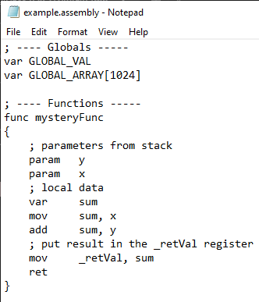
First pass
Symbol Table
Parser
Function Table
Label Table

Slide 11
Second pass
Symbol Table
Function Table
Label Table
Instruction stream
Linked List
Parser
String Table

Slide 12
Instruction stream
Linked List
Binary file
Code generator
String Table
Function Table

Slide 13
26 | 1 | 0 | 42 | 0
Opcode
Op count
Op type
Op value
Offset

Slide 14
Demo
func myFunc
{
var x
add x, 42
}
2
1 2 3 -2 0 0 42 0
29 0
Automatically append ret instruction
at the end of the function

Slide 15
Plan for week 4
Make sure Assembler work correctly before moving on to VM
Add more tests for Code generator and Assembler
Start working on Framework for Virtual Machine

